Slide 1
Unemployment
Team -11
BY: 1. Vaishnavi – (2310040138) 2. Harshith – (2310040125) 3. Manoj – (23100139) 4. Archana – (2310040131) 5. Shiva – (2310040130)

Slide 2
Introduction to Unemployment
Studying unemployment is crucial for understanding the health of an economy and the well-being of its citizens. High unemployment rates can indicate economic distress, leading to decreased consumer spending, lower tax revenues, and increased government spending on social services. By analyzing unemployment trends, policymakers can identify at-risk sectors and implement targeted interventions, fostering job creation and economic stability. Furthermore, understanding the demographics of unemployment helps address disparities and promote inclusivity in the labor market.
Beyond economic implications, unemployment has profound social consequences. Prolonged joblessness can lead to psychological stress, reduced self-esteem, and social isolation, impacting individuals and families. Communities with high unemployment rates may experience increased crime, poor health outcomes, and diminished quality of life. Studying unemployment not only informs economic strategies but also emphasizes the importance of social policies that support workforce development, mental health resources, and community resilience, ultimately contributing to a healthier society

Slide 3
Definition and Key Concepts
Unemployment refers to the condition in which individuals who are actively seeking work are unable to find employment. It is a critical indicator of economic health, reflecting the dynamics of the labor market. The labor force consists of all individuals who are either employed or actively seeking employment. The unemployment rate, a key metric, is calculated by dividing the number of unemployed individuals by the total labor force, expressed as a percentage. This rate helps gauge the level of joblessness in an economy and provides insights into economic conditions.
Underemployment is another important concept related to unemployment, referring to individuals who are working in jobs that do not fully utilize their skills, education, or availability. This can include part-time workers who wish to work full-time or those in positions that do not match their qualifications. Understanding both unemployment and underemployment is essential for policymakers and economists, as they illustrate the complexities of labor market challenges and highlight the need for strategies that promote full and meaningful employment.

Slide 4
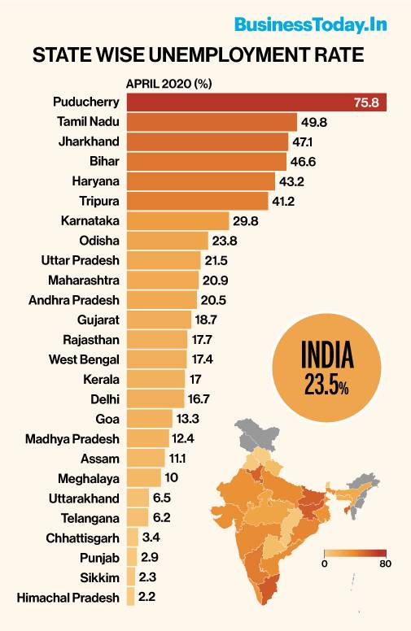
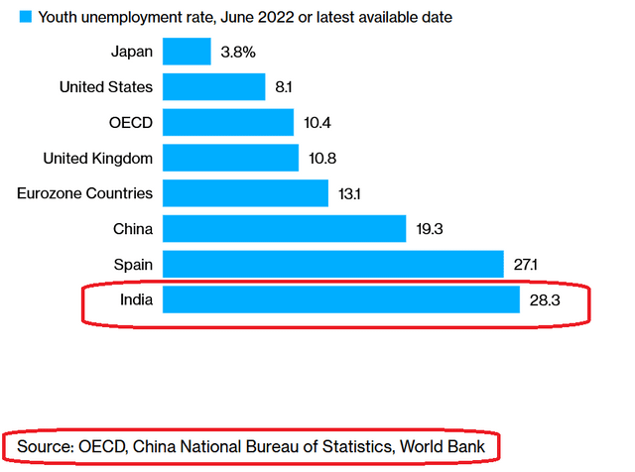

Slide 5

Causes of Unemployment
Economic factors like recession and inflation significantly influence unemployment rates. During a recession, decreased consumer demand leads businesses to cut jobs, resulting in higher unemployment. Inflation can prompt central banks to raise interest rates, which may also slow economic growth and contribute to job losses. Understanding these dynamics is vital for analyzing labor market trends and crafting effective policies.
Technological changes are another key factor affecting employment. While innovations can create new job opportunities, they can also render certain positions obsolete. Automation and AI may displace workers, highlighting the need for reskilling programs to help individuals adapt. Policymakers must ensure that education and training align with evolving job market demands to mitigate unemployment effectively.
Policy and regulatory factors play a crucial role as well. Government interventions, such as stimulus packages and labor regulations, can either foster job creation or hinder it. Effective policies support business growth and employment, while poorly designed regulations may discourage hiring. Analyzing these elements is essential for developing strategies that promote economic stability and reduce unemployment.

Slide 6
Impact on the Economy
Unemployment has a direct negative effect on GDP. When a significant portion of the labor force is unemployed, overall productivity declines, leading to lower economic output. This reduction in income also decreases consumer spending, which is a major component of GDP. As unemployment persists, economic growth slows, making recovery more challenging.
For businesses, high unemployment can create a mixed impact. On one hand, it may reduce labor costs, making it cheaper to hire employees. On the other hand, decreased consumer spending can lead to lower sales and profits, prompting companies to cut back on investment and expansion. For government budgets, rising unemployment increases expenditures on social services, such as unemployment benefits, while simultaneously decreasing tax revenues due to lower income and corporate profits. This strain can lead to budget deficits, making it harder for governments to invest in infrastructure or other economic growth initiatives.

Slide 7
Role of Education and Skills Training
Education plays a vital role in reducing unemployment by equipping individuals with the skills and knowledge needed for today’s job market. A well-educated workforce is more adaptable to changing economic conditions and technological advancements, making it easier for individuals to find and maintain employment. Education also fosters critical thinking and problem-solving skills, which are highly valued by employers.
Effective training programs can significantly enhance employability. For example, community colleges often offer vocational training that aligns with local labor market needs, providing students with practical skills in fields like healthcare, technology, and skilled trades. Programs like apprenticeships combine on-the-job training with classroom instruction, allowing participants to gain real-world experience while earning a wage. Initiatives such as coding boot camps also help individuals quickly acquire in-demand tech skills, effectively bridging the gap between education and employment opportunities.

Slide 8
Global Unemployment Trends
Recent statistics indicate that global unemployment rates have varied significantly due to economic shifts and the lingering effects of the COVID-19 pandemic. As of 2023, the global unemployment rate hovers around 5.6%, with notable differences between regions. Developed countries often report lower unemployment rates, typically ranging from 3% to 7%, reflecting more stable economies and better access to education and job training.
In contrast, developing countries face higher unemployment rates, often exceeding 8% or even higher in certain regions. Factors contributing to this disparity include limited access to quality education, a lack of infrastructure, and insufficient job creation in rapidly growing populations. Additionally, underemployment is a common issue in developing nations, where many individuals work in informal sectors or in jobs that do not utilize their skills fully. Addressing these challenges is crucial for improving employment outcomes globally and reducing the unemployment gap between developed and developing countries.

Slide 9
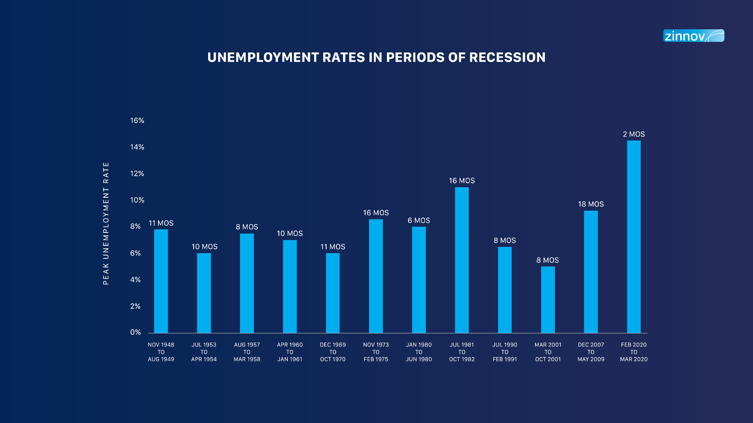
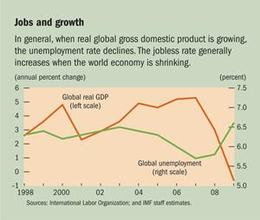

Slide 10
Impact of Technology and Automation
Automation is significantly transforming the job market by reshaping how work is performed across various industries. On one hand, it can lead to job displacement, particularly in roles involving repetitive tasks that machines can efficiently handle. For example, manufacturing and administrative positions are increasingly being automated, resulting in a decline in these jobs. This shift raises concerns about workers who may lack the skills needed to transition into new roles.
On the other hand, automation also has the potential to create jobs, particularly in tech-related fields and industries that require human oversight of automated systems. New roles in data analysis, AI management, and cybersecurity are emerging as companies adopt advanced technologies. Additionally, automation can enhance productivity, leading to business growth and the creation of new sectors and opportunities. The key challenge lies in ensuring that the workforce is equipped with the skills necessary to adapt to this changing landscape, highlighting the importance of education and training in mitigating the effects of job displacement.

Slide 11
Future Outlook for Employment
Predictions for job markets indicate significant shifts over the coming years, influenced by technology, demographic changes, and economic trends. Sectors expected to grow include technology, healthcare, renewable energy, and e-commerce. For instance, the demand for roles in artificial intelligence, cybersecurity, and software development is projected to rise as businesses increasingly rely on digital solutions. The healthcare sector is also anticipated to expand, driven by an aging population and the need for medical services.
Conversely, sectors such as traditional retail and manufacturing may face decline due to automation and changing consumer behaviors. Jobs that rely heavily on routine tasks are particularly vulnerable, as automation continues to streamline operations. Additionally, roles in fossil fuel industries may decline as the shift toward renewable energy accelerates. Adapting to these changes will require a focus on reskilling and upskilling the workforce to ensure individuals are prepared for the jobs of the future.

Slide 12
Case Studies: Unemployment in Different Regions
Case Study: India
In India, the government has implemented initiatives like the Skill India program to address high unemployment rates, particularly among youth. This program focuses on providing vocational training and skill development tailored to industry needs. For example, partnerships with the IT and manufacturing sectors have led to training in digital skills and advanced manufacturing techniques.
Key Takeaways:
Skill Development: Targeted training programs can significantly enhance employability among young people.
Public-Private Partnerships: Collaborations between government and industry can effectively bridge the skills gap in the labor market.

Slide 13
Case Study: Sub-Saharan Africa
Many countries in Sub-Saharan Africa face high unemployment, particularly among young populations. Programs like the Youth Employment Support Program in Ghana aim to provide job training and entrepreneurship support. These initiatives focus on agriculture, technology, and services, sectors with high growth potential.
Key Takeaways:
Entrepreneurship Support: Encouraging self-employment through training and access to funding can help mitigate unemployment.
Sector Focus: Identifying and investing in sectors with growth potential is crucial for job creation.
Case Study: Brazil
In Brazil, the economic downturn led to increased unemployment, particularly in the informal sector. The government launched the "Caminho da Cidadania" initiative, which provides training and job placement services, focusing on vulnerable populations.
Key Takeaways:
Targeting Vulnerable Groups: Tailored support for marginalized communities can improve job outcomes.
Integration of Services: Combining training with job placement services enhances the effectiveness of employment initiatives.

Slide 14
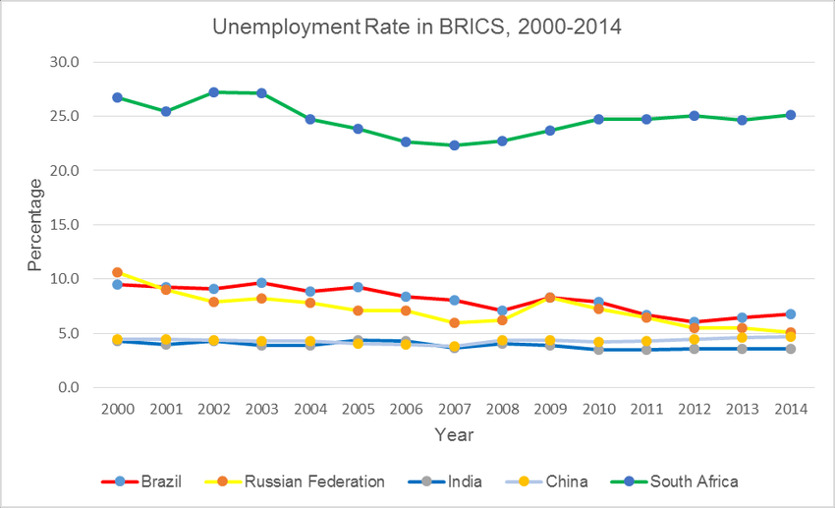
These case studies illustrate the importance of targeted skill development, public-private collaboration, and sector-specific strategies in addressing unemployment challenges in various contexts.

Slide 15
Future Outlook for Employment
Sectors Expected to Grow:
Technology: Increased demand for AI, data analysis, cybersecurity, and software development roles.
Healthcare: Rising need for healthcare professionals due to aging populations and health concerns.
Renewable Energy: Growth in jobs related to solar, wind energy, and energy efficiency.
E-commerce and Logistics: Increased demand for roles in warehousing, delivery, and supply chain management.
Sectors Expected to Decline:
Traditional Retail: Job losses in brick-and-mortar stores due to the rise of e-commerce.
Manufacturing: Displacement of routine jobs by automation and robotics.
Fossil Fuel Industries: Decline in jobs as the focus shifts to renewable energy.
Administrative Support: Decrease in roles due to automation of clerical tasks.

Slide 16
Government Policies and Solutions
Unemployment benefits provide financial assistance to individuals who lose their jobs through no fault of their own. These benefits help sustain households while individuals seek new employment. Typically funded through taxes on employers, these programs vary by country but often include monetary payments, job training services, and resources for job searching. They aim to reduce the economic impact of job loss and support consumer spending during downturns.
Job creation programs are initiatives designed to boost employment through various strategies, such as incentivizing businesses to hire or investing in public works projects. Economic stimulus measures, like fiscal policies that include tax cuts or increased government spending, aim to stimulate economic growth and create jobs. Both approaches are critical during economic downturns, helping to mitigate unemployment and foster recovery by encouraging business investment and consumer spending.

Slide 17
Youth Unemployment
Youth unemployment rates have been a persistent concern globally, often exceeding overall unemployment rates. As of recent data, many countries report youth unemployment rates ranging from 10% to over 25%, significantly higher than the national averages. Factors contributing to this disparity include economic downturns, shifts in industry demand, and a mismatch between the skills possessed by young job seekers and those required by employers.
Young job seekers face numerous challenges in the labor market. Lack of experience can hinder their ability to compete with more seasoned candidates, while limited access to networking opportunities and mentorship exacerbates this issue. Additionally, many young people struggle with job market volatility, rising living costs, and the increasing need for specialized skills, making it difficult to secure stable employment. These challenges highlight the importance of targeted policies and support systems to aid young individuals in their transition to the workforce.

Slide 18
Social and Psychological Effects
The social consequences of youth unemployment can be profound, often leading to increased crime rates and poverty levels. When young people struggle to find jobs, they may resort to illegal activities as a means of financial support, contributing to higher crime rates in their communities. Additionally, prolonged unemployment can perpetuate cycles of poverty, making it difficult for individuals and families to escape economic hardship and affecting overall community stability.
Psychologically, the effects of youth unemployment can be debilitating. Many young job seekers experience heightened stress and anxiety as they face uncertainty about their futures. This ongoing pressure can lead to feelings of inadequacy and hopelessness, increasing the risk of mental health issues such as depression. The lack of purpose and structure that often accompanies unemployment can further exacerbate these psychological challenges, highlighting the urgent need for support systems to help young people navigate their circumstances.

Slide 19
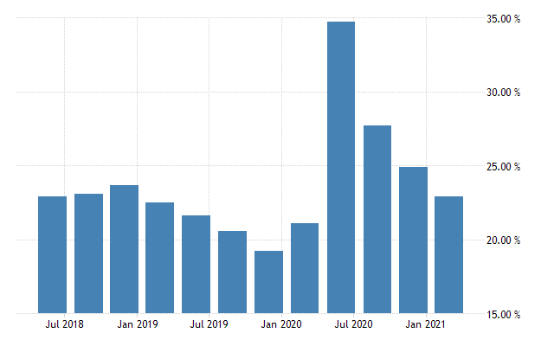
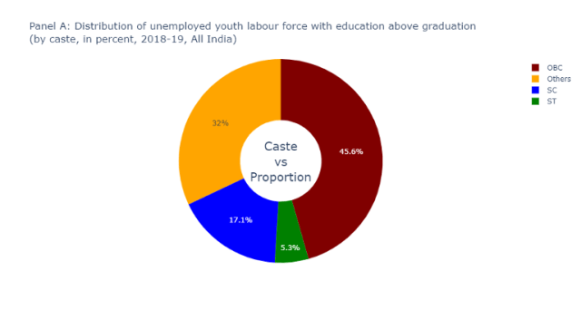

Slide 20
Thank you

